Slide 1
Digital Fundamentals
CHAPTER 4 Boolean Algebra and Logic Simplification

Slide 2
Chapter Outline
4–1 Boolean Operations and Expressions
4–2 Laws and Rules of Boolean Algebra
4–3 DeMorgan’s Theorems
4–4 Boolean Analysis of Logic Circuits
4–5 Logic Simplification Using Boolean Algebra
4–6 Standard Forms of Boolean Expressions
4–7 Boolean Expressions and Truth Tables
4–8 The Karnaugh Map
4–9 Karnaugh Map SOP Minimization
4–10 Karnaugh Map POS Minimization
4–11 The Quine-McCluskey Method
4–12 Boolean Expressions with VHDL Applied Logic

Slide 3
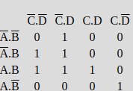
m1
m3
m4
m5
m10
m12
m13
m15

Slide 4
4–11 The Quine-McCluskey Method
For Boolean functions up to four variables, the Karnaugh map method is a powerful minimization method.
When there are five variables, the Karnaugh map method is difficult to apply and completely impractical beyond five.
The Quine-McCluskey method is a formal tabular method for applying the Boolean distributive law to various terms to find the minimum sum of products by eliminating literals that appear in two terms as complements.

Slide 5
4–11 The Quine-McCluskey Method
Implicant:
Prime Implicant:Implicant that can not be grown to a bigger implicant anymore.
Essential prime implicant: A prime implicant that covers at least 1 minterm that is not covered by any other prime implicant

Slide 6
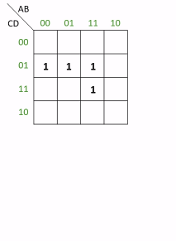
4–11 The Quine-McCluskey Method

Slide 7
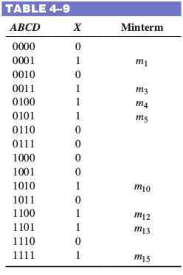
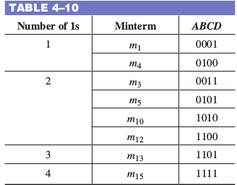
EXAMPLE: The Quine-McCluskey Method
represent it as binary numbers on the truth table
Arrange the minterms in the original expression in groups according to the number of 1s in each minterm
Minterm = 8

Slide 8
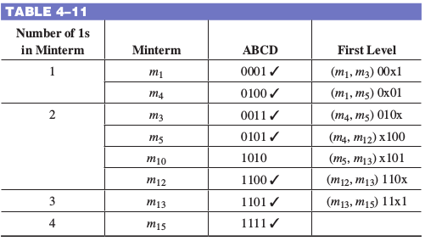
EXAMPLE: The Quine-McCluskey Method
Compare adjacent groups, looking to see if any minterms are the same in every position except one. If they are, place a check mark by those two minterms,
m₁₀ does not have a check mark because no other minterm meets the requirement of being identical except for one position. This term is called an essential prime implicant, and it must be included in the final reduced expression.
An essential prime implicant is a product term that cannot be further simplified by combining with other terms.

Slide 9
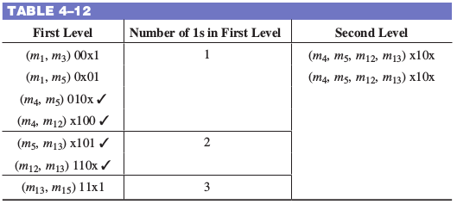
EXAMPLE: The Quine-McCluskey Method
compare these terms only if the x is in the same relative position in adjacent groups; otherwise go on. If the two expressions differ by exactly one position, a check mark is placed next to both terms as before and all of the minterms are listed in the Second level list. As before, the one position that has changed is entered as an x in the Second level. third term in Group 1 and the second term in Group 2 meet this requirement, differing only with the A literal. The fourth term in Group 1 also can be combined with the first term in Group 2, forming a redundant set of minterms. One of these can be crossed off the list and will not be used in the final expression.

Slide 10
EXAMPLE: The Quine-McCluskey Method
With complicated expressions, the process described can be continued. For our example, we can read the Second level expression as BC. The terms that are unchecked will form other terms in the final reduced expression. The first unchecked term is read as A BD.
The next one is read as A CD. The last unchecked term is ABD. Recall that m₁₀ was an essential prime implicant, so is picked up in the final expression. The reduced expression using the unchecked terms is:
X = BC + A BD + A CD + ABD + ABCD

Slide 11
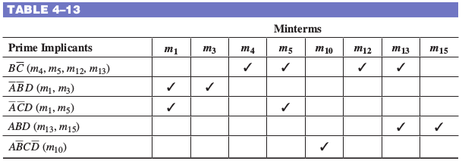
EXAMPLE: The Quine-McCluskey Method
X = BC + A BD + A CD + ABD + ABCD
Although this expression is correct, it may not be the minimum possible expression. There is a final check that can eliminate any unnecessary terms. The terms for the expression are written into a prime implicant table, with minterms for each prime implicant checked, as shown in Table 4–13.
If a minterm has a single check mark, then the prime implicant is essential and must
be included in the final expression. The term ABD must be included because m₁₅ is only
covered by it. Likewise m₁₀ is only covered by ABCD, so it must be in the final expres-sion Notice that the two minterms in A CD are covered by the prime implicants in the first two rows, so this term is unnecessary. The final reduced expression is, therefore,

